Slide 1

تخرجي
قالب بوربوينت لمشاريع التخرج

Slide 2


UNIVERSITY OF ADEN
FACULTY OF ENGINEERING
Information Technology Engineering Department
Inventory Management System (IMS)
Prepared by:
Abduljalil Hassan Qaid Ali 167559 Supervisor
Zaher Fahed Ali Abdualjulil 167591 Dr. Waddah Munassar
Bander Abdo Abdullah zaid 167588
Ac Year : 2020/2021
المقــــدمة
Inventory Management System (IMS)

Slide 3
Introduction
Introduction
Pervious work
Methodologies
Analyses
Forms Design
Reports
Inventory Management System (IMS)

Slide 4

عن صاحب المشروع
Existing System:
Current system is a manual one in which users are maintaining ledgers, books.. Etc. to store the information, It is very difficult to maintain historical data, More manual hours need to generate required reports…etc.
Difficult
Bad security
Inventory Management System (IMS)

Slide 5

عن صاحب المشروع
Proposed System:
Proposed system is a software application which avoids more manual hours that need to spend in record keeping and generating reports
Eazy
High security
Inventory Management System (IMS)

Slide 6
Scope:
very easy to manage historical data in database. No specific training is required for the employees to use this application.
powerful management of the users and to take them privileges.
Inventory Management System (IMS)

Slide 7
Objectives
High protection for documents and is safe to information.
A backup of a daily data or after work.
Easy to know the items in the store.
powerful management of the users.
Easy to manage all the daily transactions.
Can generate required reports easily.
Easy to manage historical data in a secure manner.
Easy to use GUI that does not requires specific training.
Inventory Management System (IMS)

Slide 8
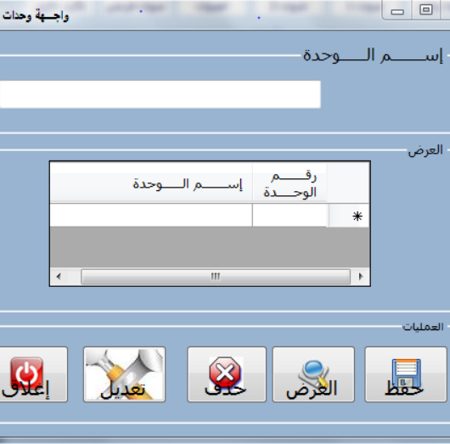
Inventory Management System (IMS)
Previous work
inventory of the University of Sabh
Graduation Search The Bachelor's degree prepared by Somia Abdulqader and Maryam Abdulqader.
Software used in the design: Building and documenting this research, which adopts the design of the warehouse system for the Faculty of Al-Alou Languages, which is: as follows:2010 Basic Visula for designing and programming

Slide 9
Inventory Management System (IMS)
Previous work
inventory of the University of Sabh
Disadvantage of project:
Can’t to development in future because low in analyses database.
Can’t generate required reports easily.
Easy to use GUI that does not requires.
Not monitored all the operational store as required.
Bad at system privileges and users management.

Slide 10
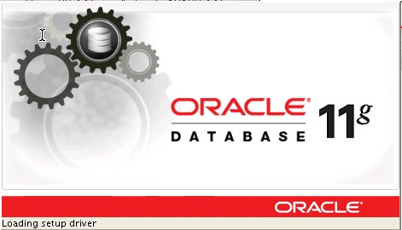
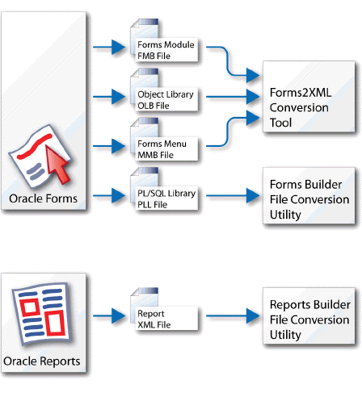


عن صاحب المشروع
Methodologies
Oracle
The most popular database in the world ,It has a large community .
Larry Ellison and his two friends and former co-workers, Software Development Laboratories (SDL) in 1977,written in Assembly ,C and C++.initial release 1979 by oracle corporation.
Inventory Management System (IMS)

Slide 11

Inventory Management System (IMS)
Methodologies
Oracle 11g
Sql Developer
Toad For oracle
Form Builder
Report Builder
Oracle Database 11g is designed along the following feature areas to help organizations manage infrastructure grids easily and deliver high-quality service:
Developed in Java
Supports Windows, Linux, and Mac OS X platforms
Connects to any Oracle Database
is the only developer tool that helps you simplify your workflow, reduce code defects and improve code quality and performance while supporting team collaboration
Form Builder is the main application-building component of Oracle Forms Developer by using sql & pl sql
A query builder with a graphical representation of the SQL statement to obtain
report data

Slide 12
Inventory Management System (IMS)
Methodologies
Sql Developer
Form Builder
02
04
01
03
05
Oracle 11g
Toad For oracle
Report Builder

Slide 13
Break

Slide 14

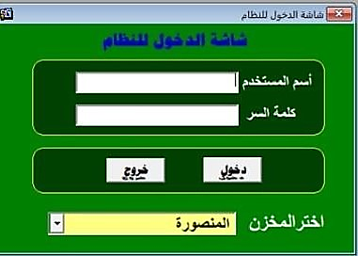
Login
USE
HOW TO USE
Inventory Management System (IMS)

Slide 15
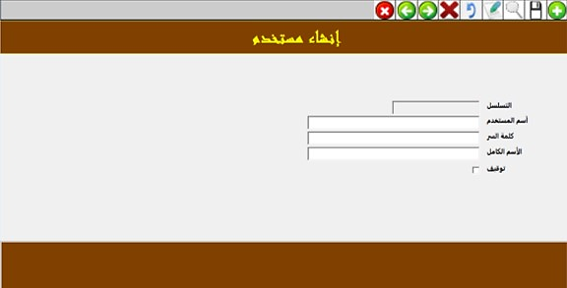
Users
USE
HOW TO USE
Inventory Management System (IMS)

Slide 16
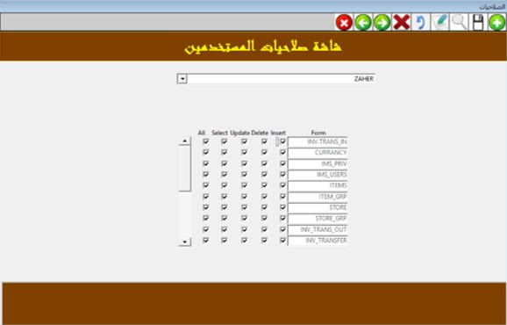
privileges
USE
HOW TO USE
Inventory Management System (IMS)

Slide 17
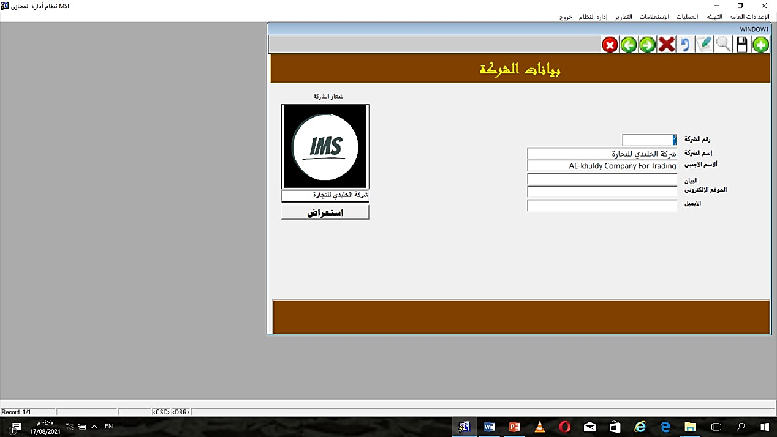
Company
USE
HOW TO USE
Inventory Management System (IMS)

Slide 18
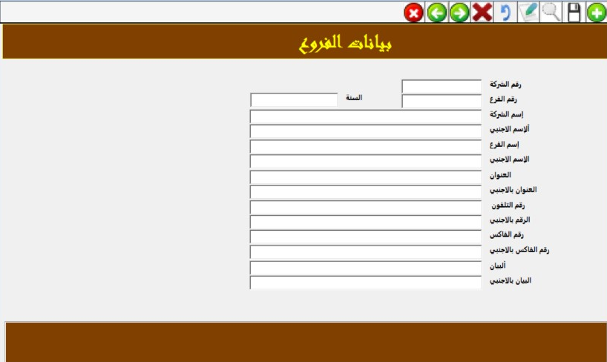
Branch
USE
HOW TO USE
Inventory Management System (IMS)

Slide 19
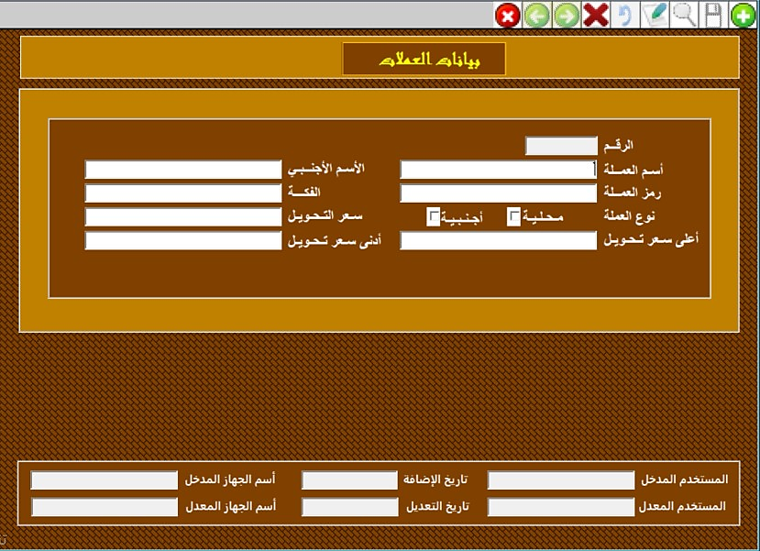
Currancy
USE
HOW TO USE
Inventory Management System (IMS)

Slide 20
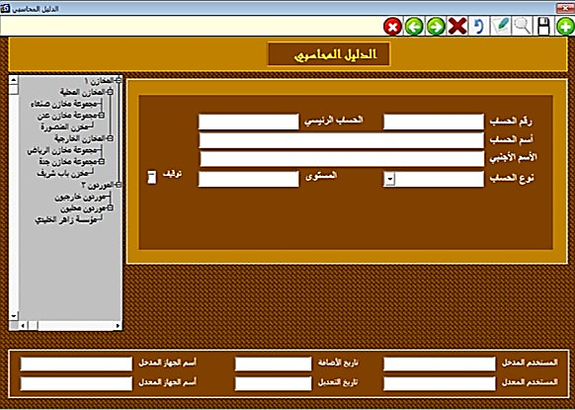
Accounts
USE
HOW TO USE
Inventory Management System (IMS)

Slide 21
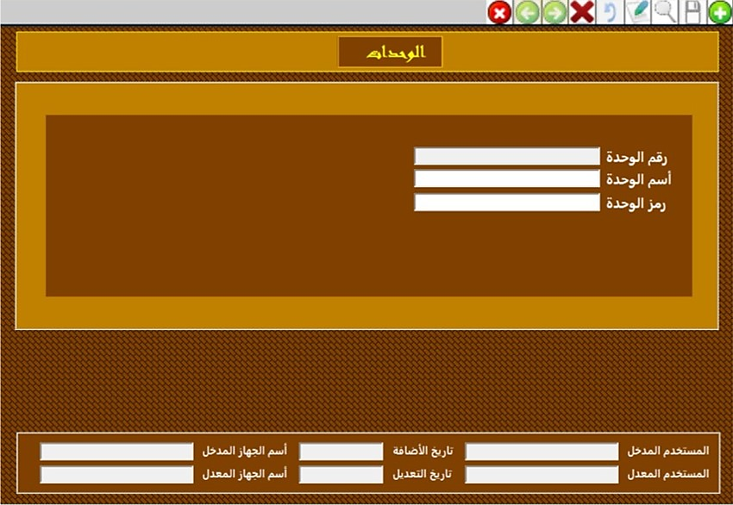
Units
USE
HOW TO USE
Inventory Management System (IMS)

Slide 22
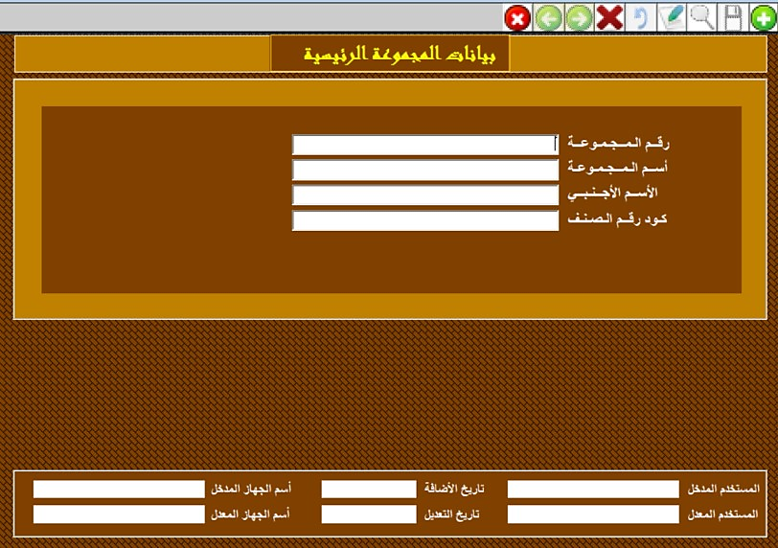
ITEM_GRP
USE
HOW TO USE
Inventory Management System (IMS)

Slide 23
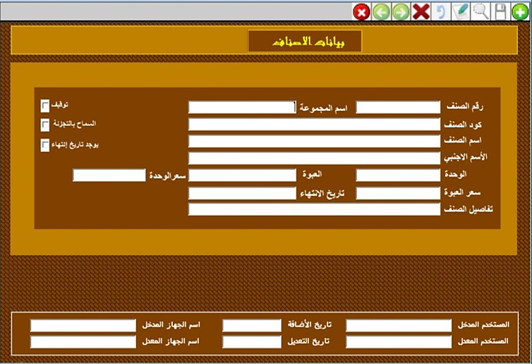
ITEMS
USE
HOW TO USE
Inventory Management System (IMS)

Slide 24
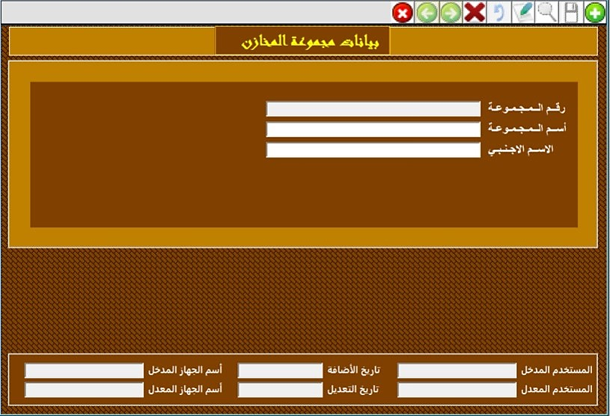
STORES_GRP
USE
HOW TO USE
Inventory Management System (IMS)

Slide 25
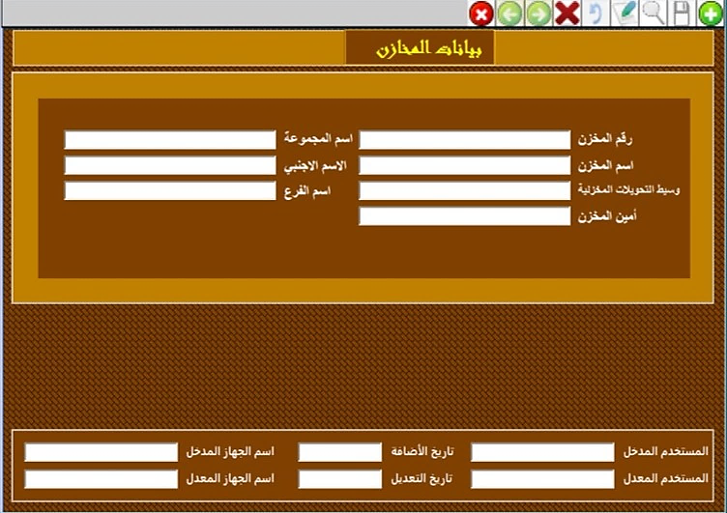
STORES
USE
HOW TO USE
Inventory Management System (IMS)

Slide 26
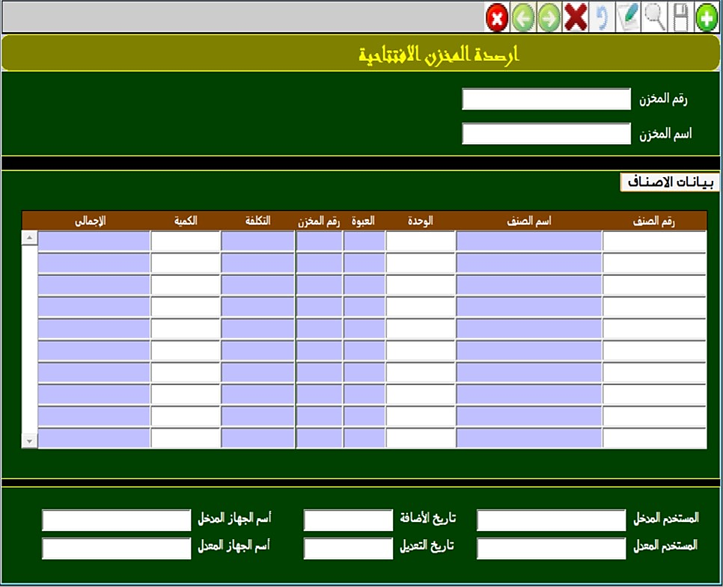
OPEN_BALANCE_
STOER
USE
HOW TO USE
Inventory Management System (IMS)

Slide 27
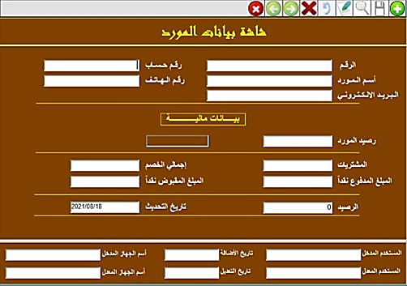
Vendors
USE
HOW TO USE
Inventory Management System (IMS)

Slide 28
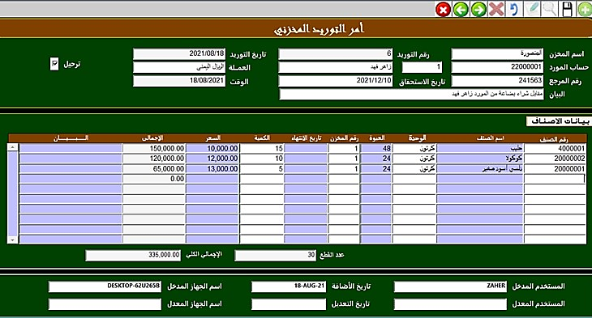
INV_TRANS_IN
USE
HOW TO USE
Inventory Management System (IMS)

Slide 29
Break

Slide 30
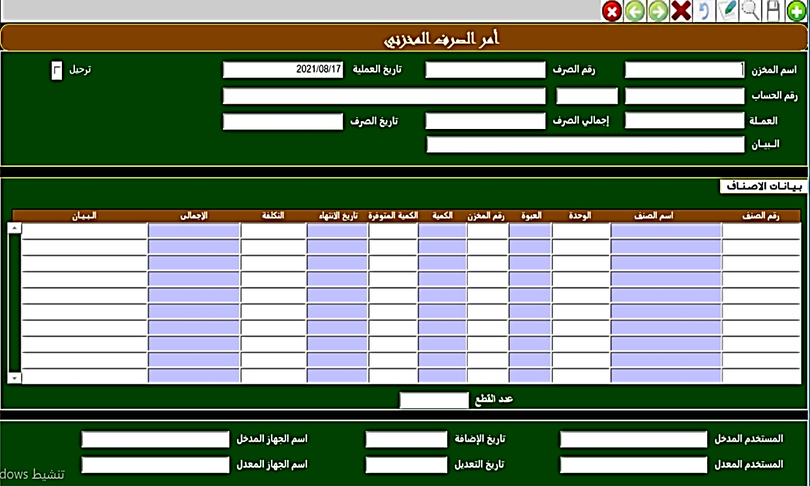
INV_TRANS_OUT
USE
HOW TO USE
Inventory Management System (IMS)

Slide 31
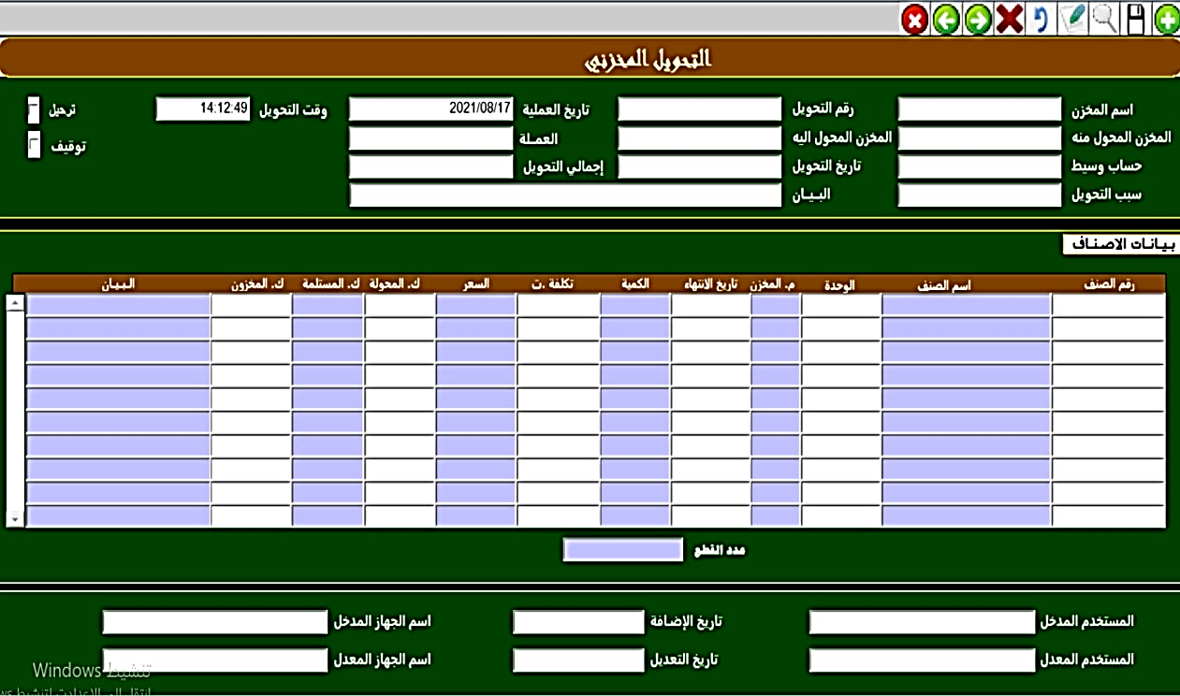
INV_TRANSFER
USE
HOW TO USE
Inventory Management System (IMS)

Slide 32
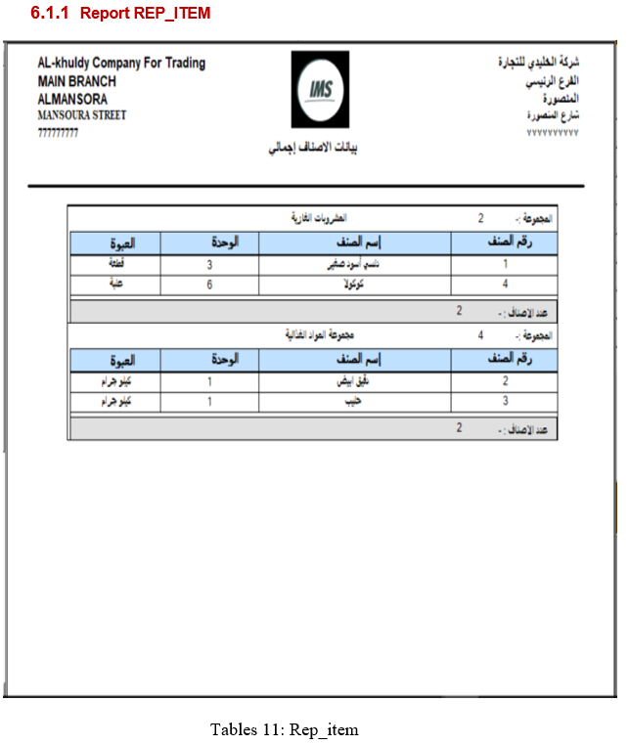
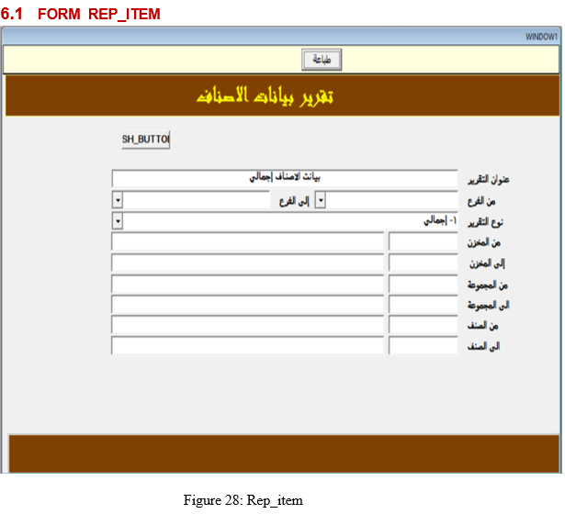
Inventory Management System (IMS)

Slide 33
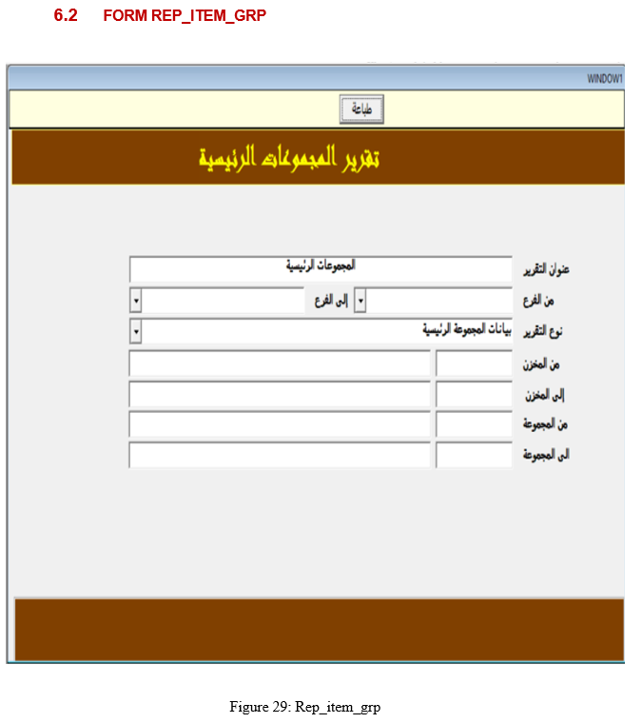
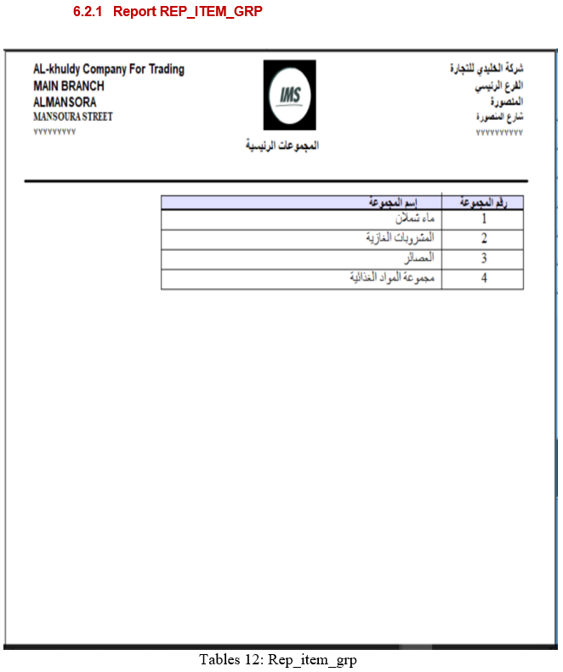
Inventory Management System (IMS)

Slide 34
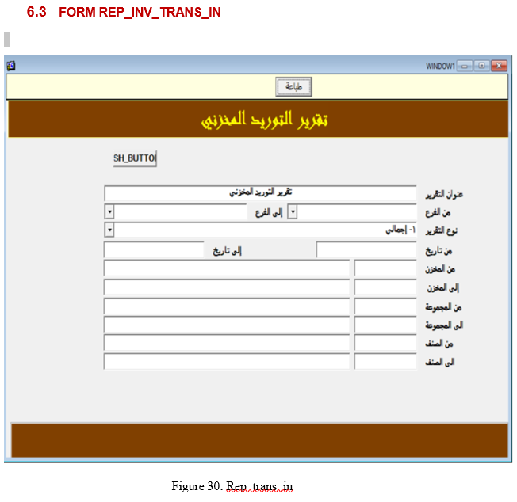
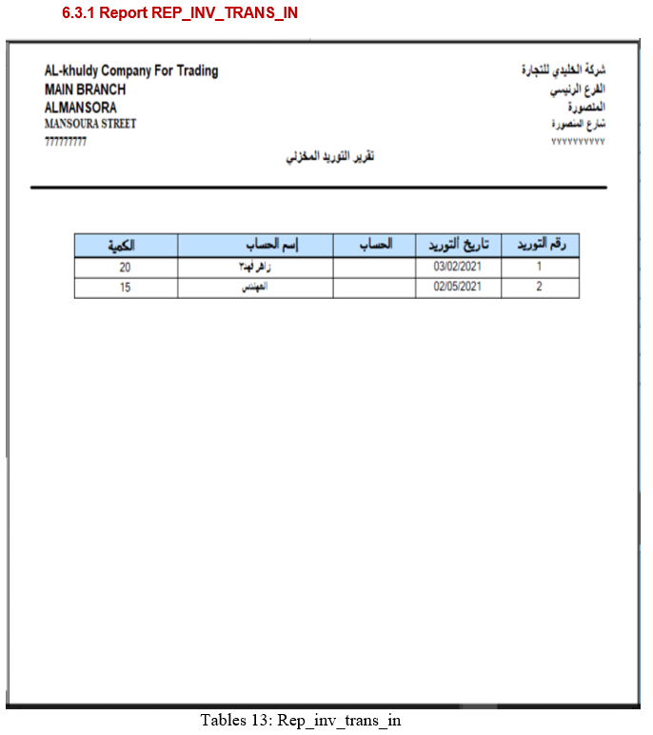
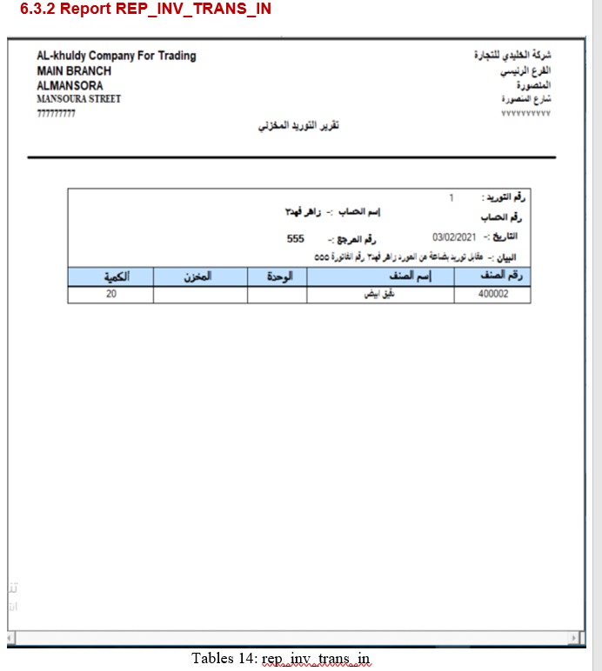
Inventory Management System (IMS)

Slide 35
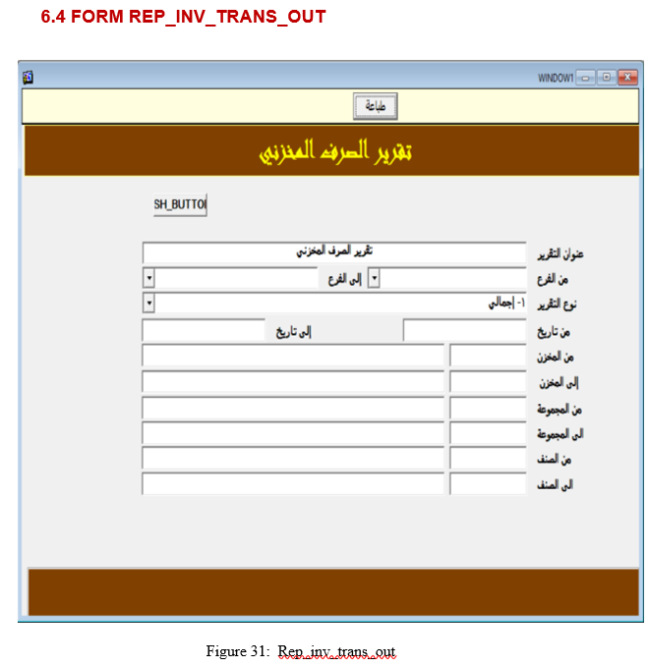
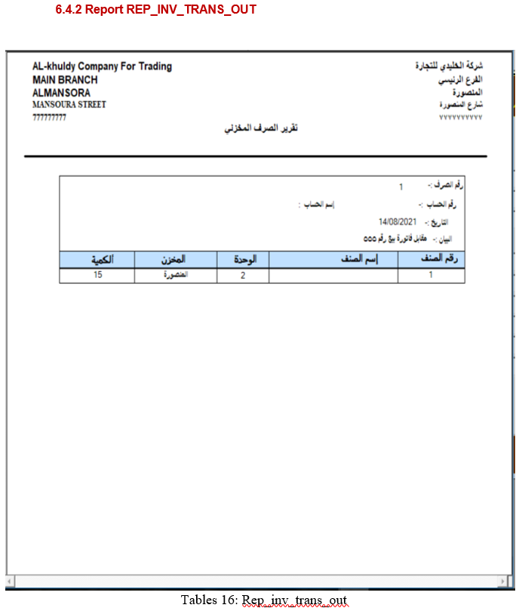
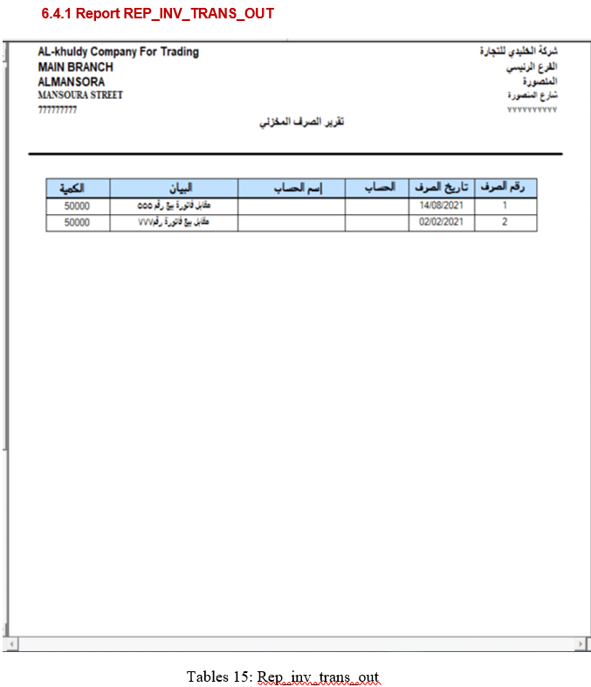
Inventory Management System (IMS)

Slide 36
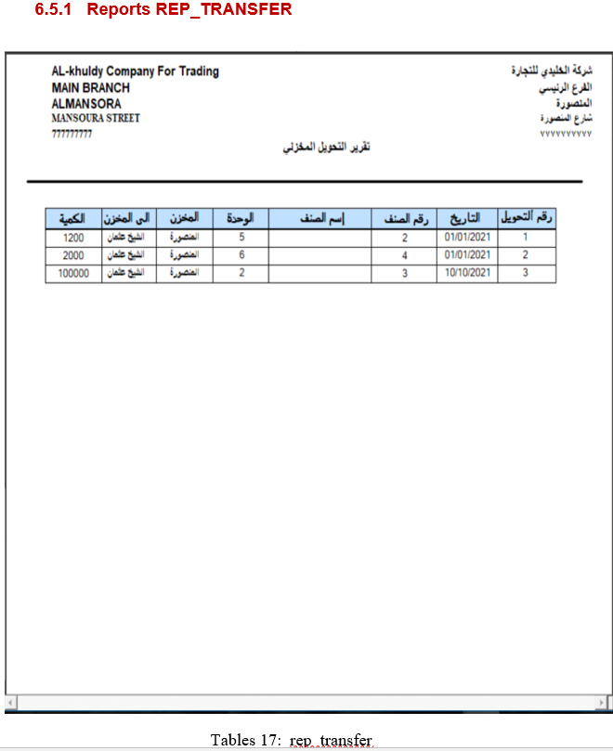
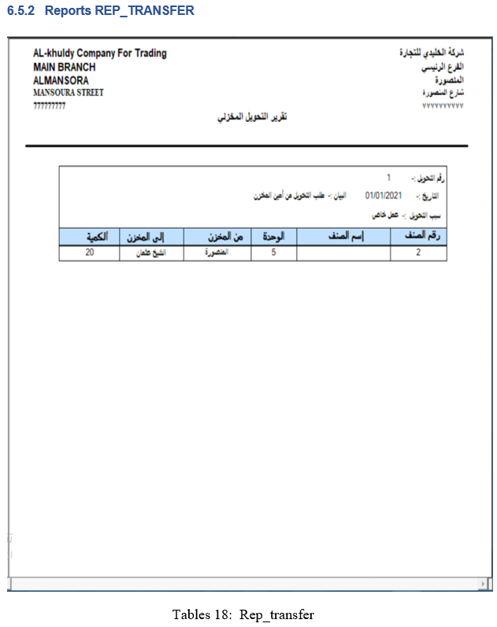
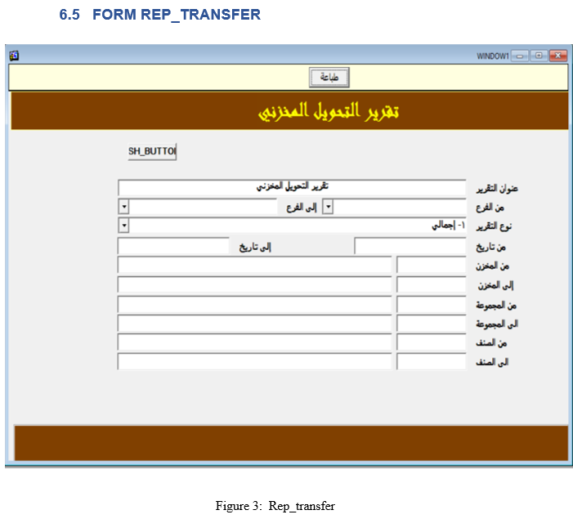
Inventory Management System (IMS)

Slide 37
Conclusion
The efficiency of any system designed to suit an organization depends cooperation during the implementation stage and also flexibility of the system to adopt itself to the organization.
“Inventory Management System (IMS)” has been developed to overcome the problems with traditional Inventory management in large scale. Advantages over traditional manual systems are desktop application access through out all the users from the same system, reducing the manual work, storage the data at a secured centralized locations and quick generation of reports as per our requirements.
In the future will be inshallah to development this system to website, Desktop and Mobile Application by using Oracle Apex Frameworks and development to become ERP System.
Inventory Management System (IMS)

Slide 38
Thanks
Inventory Management System (IMS)

